Slide 1
The Case for God
Francisco Rodriguez P

Slide 2
Introduction of book
Written by Karen Armstrong
She describes and goes in detail about how far humankind will go in order to experience a “sacred reality”
Introduces a different outlook on God
How to try to understand what God is and how we use the idea of God in our daily lives

Slide 3
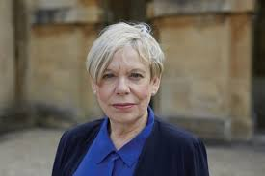
Who is Karen Armstrong?
British Author
Written many works on religion*
Oxford Alumni
Former Roman Catholic religious sister
*Awarded the Princess of Asturius Award

Slide 4
Why she left the sisterhood
A former nun, Karen Armstrong lost her faith while studying at Oxford and then spent years trying to build an alternative career as an academic and TV presenter.

Slide 5
Before we get into it
Born into a Catholic Family
Felt forced to do something I didn’t believe in
Converted into Buddhism
The one who can keep cool during chaos succeeded
Now a humanistic non-believer

Slide 6
Reason Ch.3
Begins with the how the Greeks started to think differently
These Greeks were milesians who were naturalists that focused entirely on the material world
They banded together and became known as the phusikoi in the Greek language

Slide 7
What is a Milesian?
The milesians were wealthy merchants
Believed in an explanation for everything
They were convinced that there was an underlying order and that the universe was governed by intellegible laws.

Slide 8
Phusikoi
To set their trade apart from their views they went under the name of phusikoi
*They did not have a large following
Launched the Western scientific tradition
*Proposed a question

Slide 9
The arche
*Believed that the arche was the beginning of the cosmos
In search of the raw material that had existed before the universe had emerged

Slide 10
Phusikoi and their faith
Not hostile toward Greek religion*
No orthodox doctrines of creation in Greek religion
The Gods of Mount Olympus were neither omnipotent nor cosmic powers

Slide 11
Homer
*Fixated the gods’ personalities for all time
When contemplating the Olympian family, their complexity grew increasingly similar to mortal men and women
*Sensed the presence of a deity in any exceptional human achievement

Slide 12
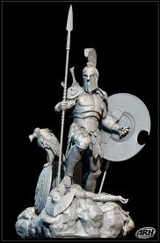
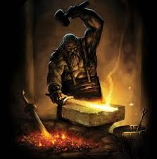
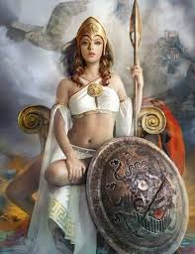
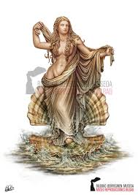
War Love Art Victory

Slide 13

Learning of different views
*On their trade routes the phusikoi encountered Eastern culture and started to stray away from the Greek Gods
Wanted to disprove Zeus’ existence
Began a new way of thinking

Slide 14
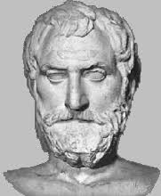
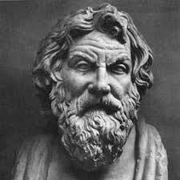
Breaking down of the elements
Thales ( 580 B.C.E.)
water
Anaximenes ( 560 - 496 B.C.E.)
air

Slide 15
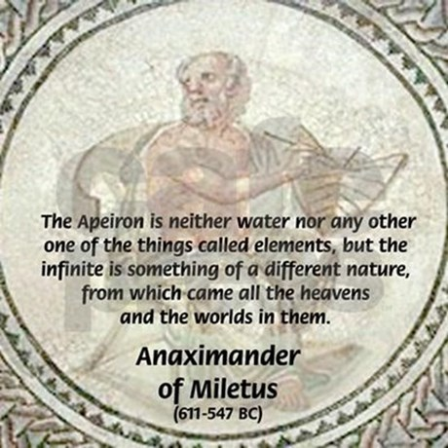
Apeiron
Anaximander

Slide 16
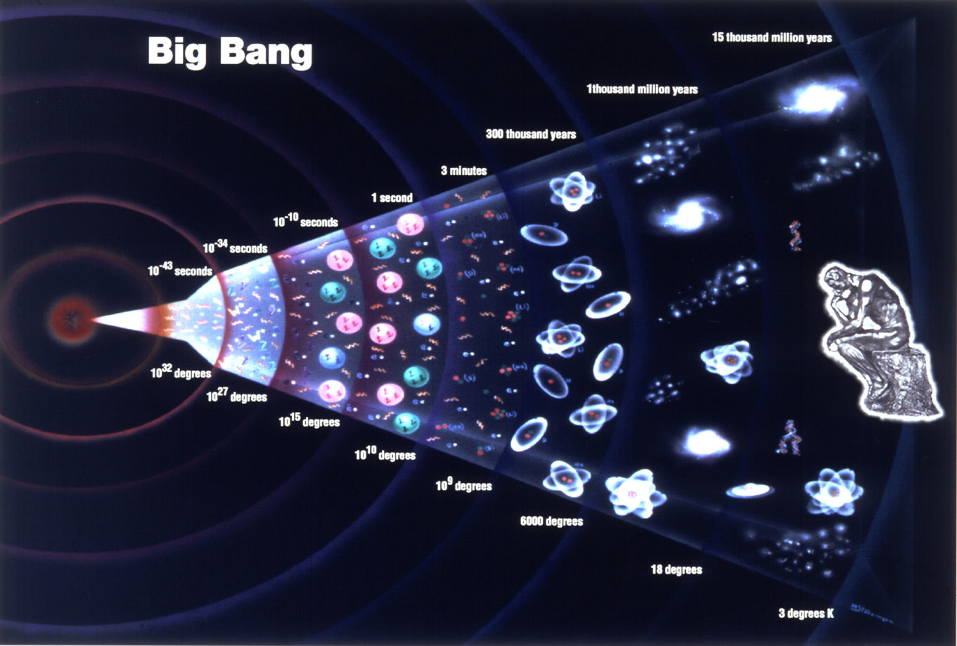
Big Bang Connection

Slide 17
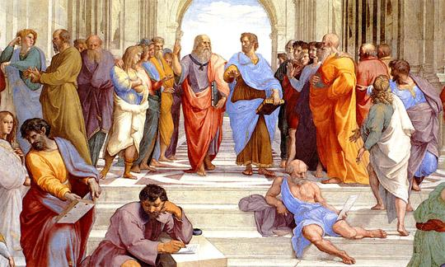
Philosophy

Slide 18
In conclusion
Focused on Ch.3 Reason
Which broke down how humans began to question everything
How and where their minds began to go toward (Arche , Apeiron, Philosophy)
Only the rich could start to think this way which began humans scientific tradition to question what was not allowed to be questioned because no one would punish them. (except socrates)

Slide 19
Final words - Marcus Aurelius
Live a good life. If there are gods and they are just, then they will not care how devout you have been, but will welcome you based on the virtues you have lived by.
If there are gods, but unjust, then you should not want to worship them.
If there are no gods, then you will have lived a noble life that will live on in the memories of your loved ones.

